Slide 1
T2DM RELAPSE DOPO MBS: FATTORI DI RISCHIO E FATTORI PREDITTIVI DI SUCCESSO
Prof. Francesco Rubino, MD
Chair Metabolic and Bariatric Surgery
King’s College London
Consultant (Hon) Bariatric Surgeon
King’s College Hospital

Slide 2
Personal Disclosures
Research/Educational Grants: Medtronic, Ethicon
Scientific Advisory Board: Keyron, GT Metabolic Solution, Kailera
Speaking honoraria: Medtronic, Johnson & Johnson, Novo Nordisk, Eli Lilly, Astra Zeneca

Slide 3
Content
1
Background: (Diabetes Surgery, not Weight Loss Surgery)
2
Definition of Remission
3
Predicting factors of remission and relapse
4
Surgical treatment of diabetes, beyond remission
5
Brief mechanistic considerations: no, diabetes remission is not due to weight loss
6
Surgery as Disease Treatment vs Prophylactic Intervention

Slide 4

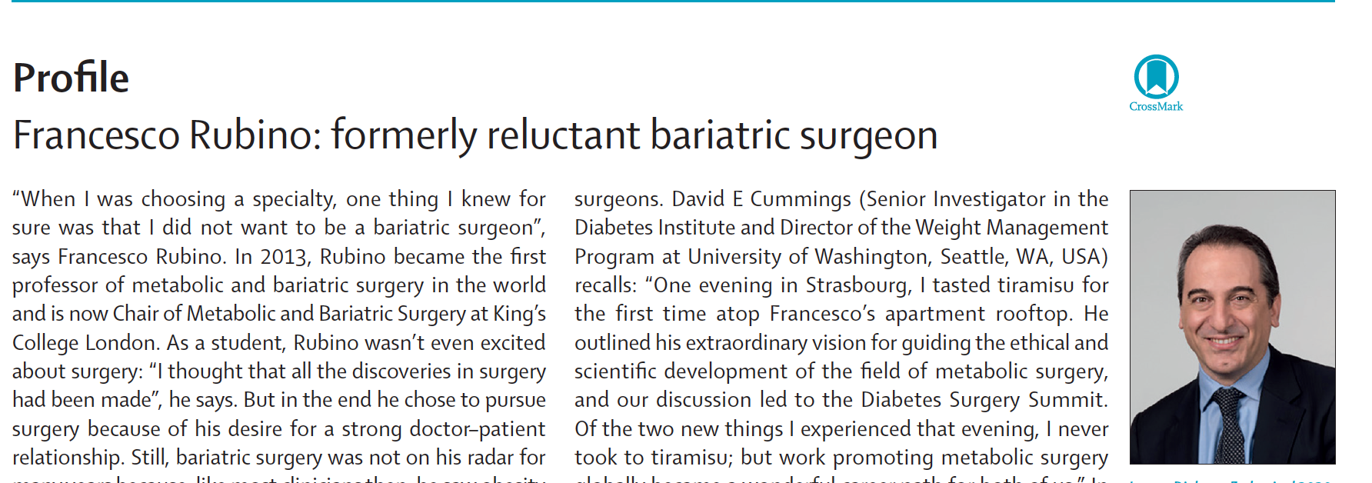

Slide 5
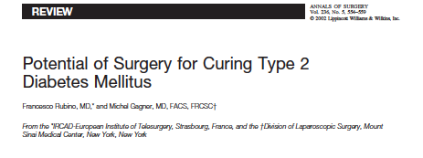
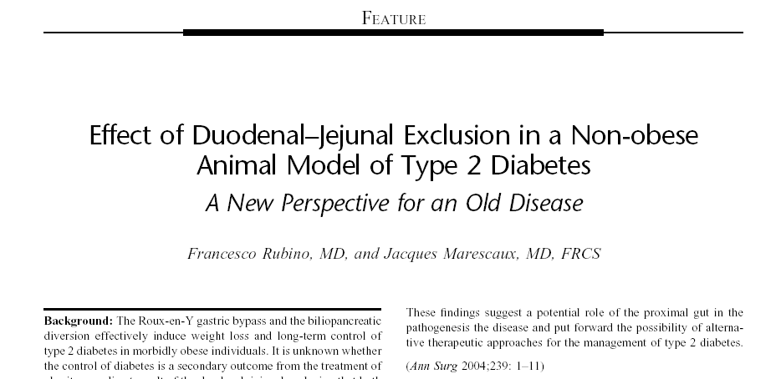
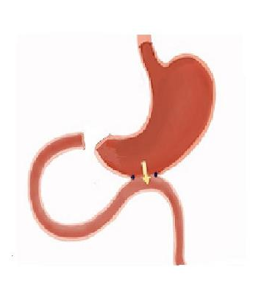
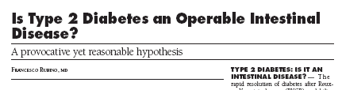

Slide 6


Speaking about “Diabetes Surgery”
in the early 2000s…
…“Rubino's idea boils down to one impolite word used to refer to the excrement of cows”….
“BS”

Slide 7
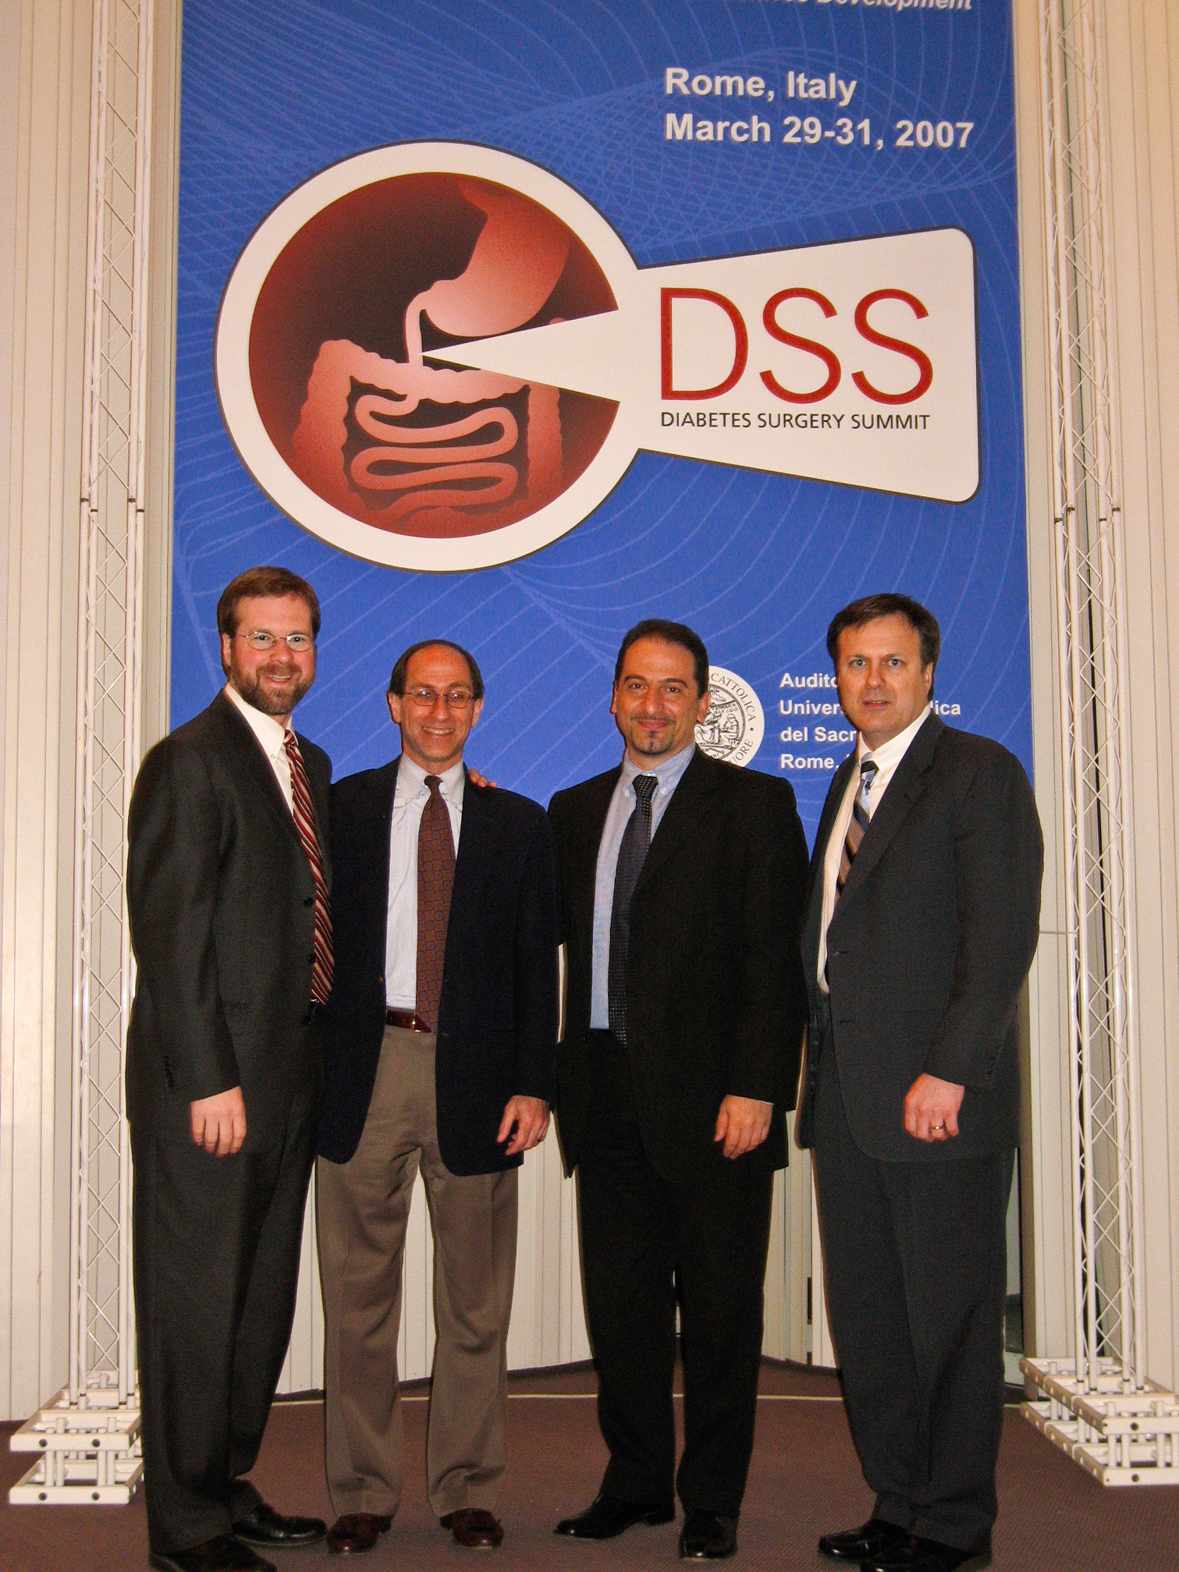
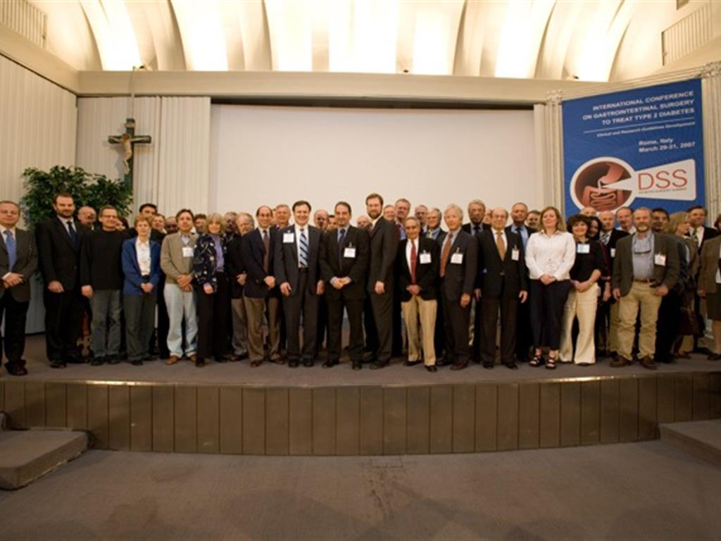
1st International Consensus Conference on GI Surgery for Type 2 Diabetes
Rome, Italy, 2007
DIABETES SURGERY SUMMIT (DSS)

Slide 8
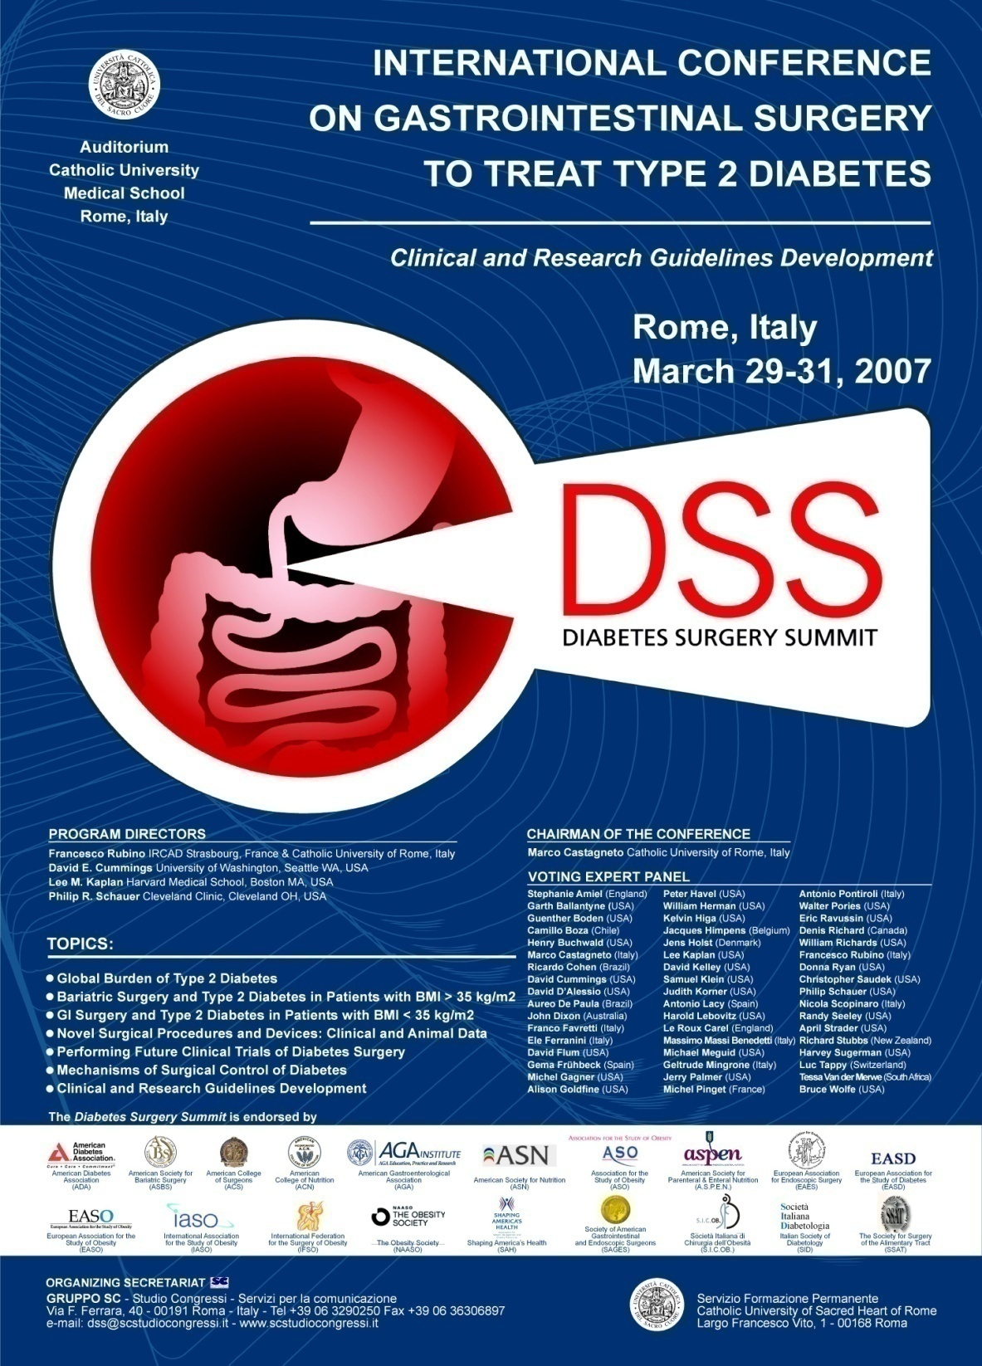


Slide 9
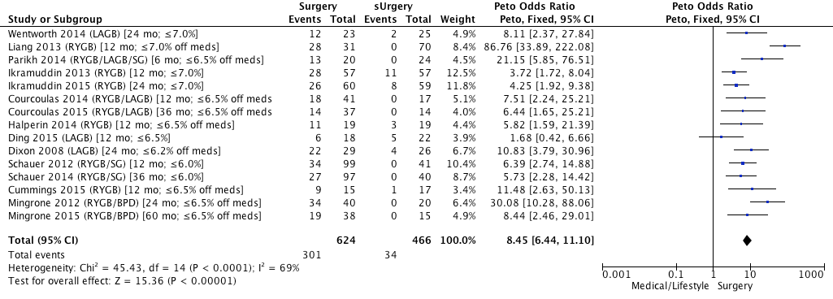
RCTs of Surgery vs. Meds/Lifestyle Care for T2DM
Surgery
Medical/
Lifestyle
Study (Operation) [Follow-up; HbA1c endpoint]
Glyc. Endp. N Glyc. Endp. N
Weight
Peto, Fixed, 95% CI
Peto Odds Ratios
Level 1A Evidence:
Surgical Superiority
BMI ≤ 35
]
]
BMI > 35
Ascending Mean Baseline BMI
Fixed Effect Model
Medical/Lifestyle Surgery
Favors
Meds-Lifestyle
Favors
Surgery
Rubino F et al Diabetes Care (June 2016)

Slide 11
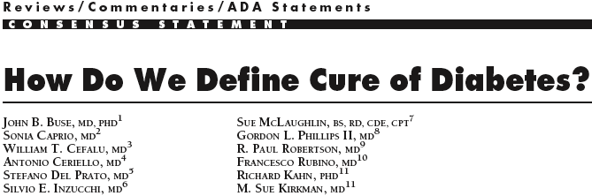
How do we define remission?
ADA 2021 definition of diabetes remission
HbA1c < 6.5%
for at least 3 months without glucose-lowering medication
ADA Consensus Statement, Diabetes Care 2009
(at least 1 year in the 2009 definition)
“Cure = persistent state of diabetes remission for at least 5-year duration”
Diabetes Care 2009;32:2133. Riddle MC, et al. Consensus Report: Diabetes Care 2021;44(10):2438–2444.

Slide 12
Remission and Relapse

Slide 13
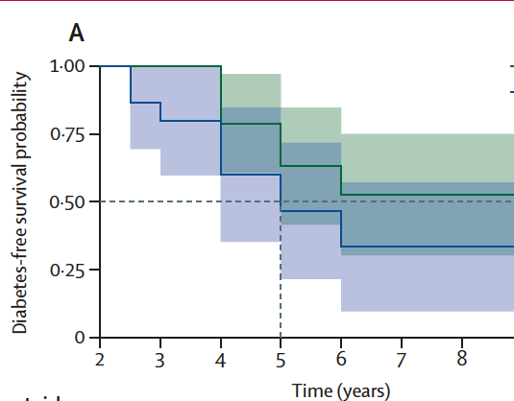

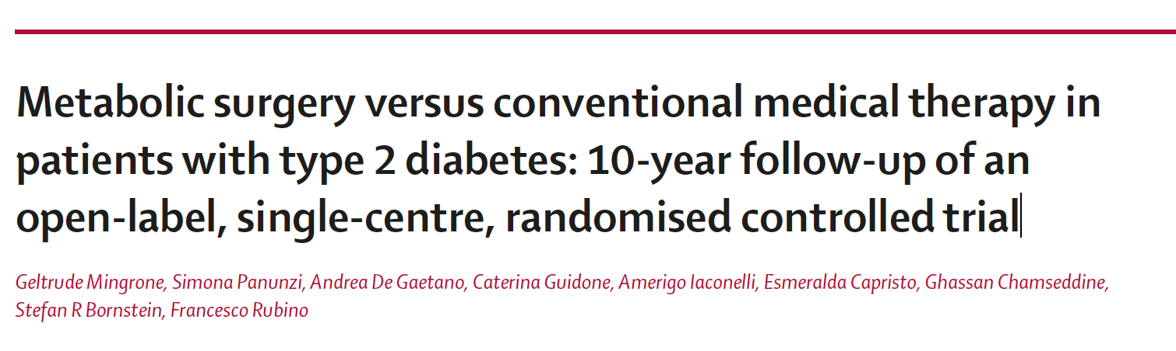
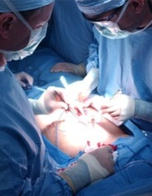

10-Year Outcomes of Metabolic Surgery for Type 2 Diabetes
10-year Remission of Diabetes in RCT
Surgery (Total) : 37.5%
Medical Therapy: 0%
BPD (50%; CI: 30.0; 70.1),
RYGB (25%; CI: 11.2; 46.9)
(P=0.19, Fisher exact test between surgical procedures)
Jan 2021
vs

Slide 14
Prediction of initial remission
Preoperative predictors and their interpretation
Outcome: medication-free glycaemic remission at a prespecified time · Baseline signals: diabetes duration, age, HbA1c, treatment intensity and C-peptide · Evidence: more studies, but usually only 6–36 months of follow-up
Predictor | Direction of association | What it probably captures | Evidence
Diabetes duration | Shorter favours remission | Disease stage and residual β-cell function | Most reproducible
Age | Younger favours remission | Disease stage and reserve | Consistent, but not a cutoff
HbA1c / fasting glucose | Lower favours remission | Glycaemic severity | Consistent
Insulin / medication burden | Less treatment favours remission | β-cell failure and severity | Strong, confounded by indication
Fasting C-peptide | Higher favours remission | Endogenous insulin secretion | Stronger evidence in Asian cohorts
BMI | Inconsistent | Poor proxy for metabolic phenotype | Not reliable alone
Candidate biomarkers such as GLP-1, bile acids, adipokines and microbiome features remain exploratory.
Cureus 2020, doi:10.7759/cureus.9973; Zhang et al. Br J Surg 2016, doi:10.1002/bjs.10255; Wang et al. 2014; Chen and Kong, J Diabetes Investig 2018, doi:10.1111/jdi.12871.

Slide 15
Relapse is common over long follow-up
2,090 patients
20.1% relapsed after remission at two years in the Swedish registry cohort.
736 patients
32% of patients who remitted later relapsed in a cohort followed for at least five years.
Jans et al. SOARD 2021, doi:10.1016/j.soard.2021.12.005; Aminian et al. Diabetes Care 2020.

Slide 16
Predicting Factors of Relapse
Preoperative state
Early response
Long-term course
Baseline
First year
Later follow-up
Diabetes duration
HbA1c
Insulin and medications
C-peptide
Procedure
Weight loss
HbA1c trajectory
Medication reduction
Early complications
Weight regain slope
Glycaemic drift
Medication restart
Anatomical or nutritional issues
Weight regain contributes to relapse, but it is not the sole mechanism.
Some patients relapse despite sustained weight loss; others improve glycaemia without meeting formal remission criteria.
A low predicted chance of remission does not mean surgery will fail.
Patients who do not achieve formal remission may still improve glycaemia, reduce insulin requirements and gain other clinically important benefits.
Jans et al. 2021; Aminian et al. 2020; Oliveira et al. 2017
Oliveira et al. 2017; Zhang et al. 2016..

Slide 17
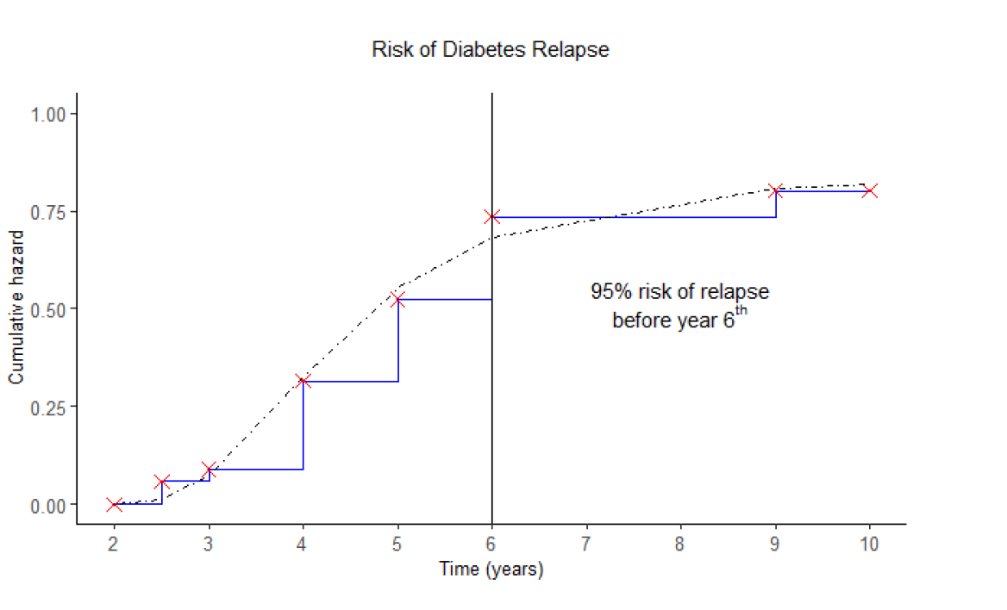
10-Year Outcomes of Metabolic Surgery for Type 2 Diabetes
Jan 2021
vs
All patients who experienced relapse of hyperglycaemia maintained good glycaemic control at 10-year (mean 10-year HbA1c was 6.7±0.19%; all but one patient had HbA1c<7.0)

Slide 18
Existing scores mainly predict short-term remission
Tool | Inputs | Primary target | Main limitation
DiaRem | Age, HbA1c, medications, insulin | Short-term remission | Does not directly model β-cell reserve
ABCD | Age, BMI, C-peptide, diabetes duration | Short-term remission | BMI contribution may not generalise
DiaRem2 | Refined baseline clinical variables | Short-term remission | Durability evidence remains limited
Individualized Metabolic Surgery Score | Disease severity and procedure-related variables | Procedure-specific outcomes | More complex and requires external validation
Prediction should guide counselling and follow-up, not surgical indication
What we know
What we do not know (well)
Future research
Disease duration, age, baseline glycaemia, insulin and medication burden, β-cell reserve and postoperative weight trajectory.
Long-term relapse models, procedure comparisons and novel biomarkers lack consistent definitions and broad external validation.
A prospective multicentre model with standardized outcomes, repeated measurements and validation across procedures and populations.
Zhang et al. Br J Surg 2016, doi:10.1002/bjs.10255.

Slide 19
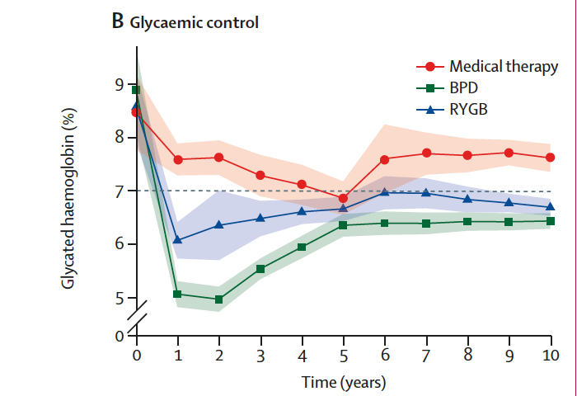
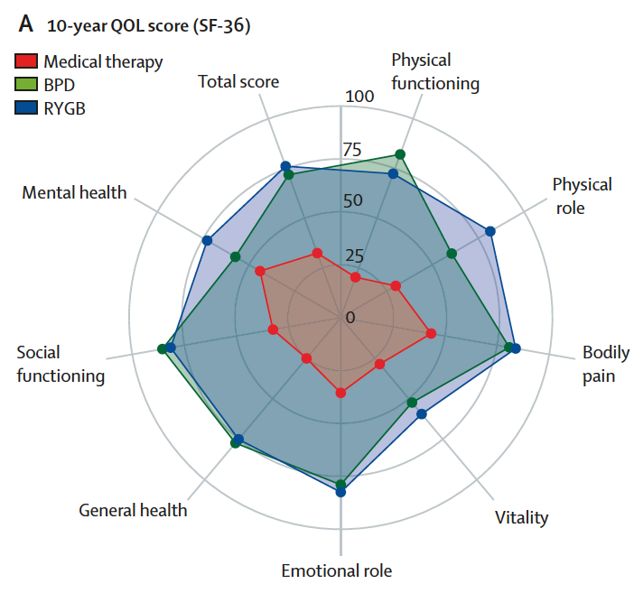
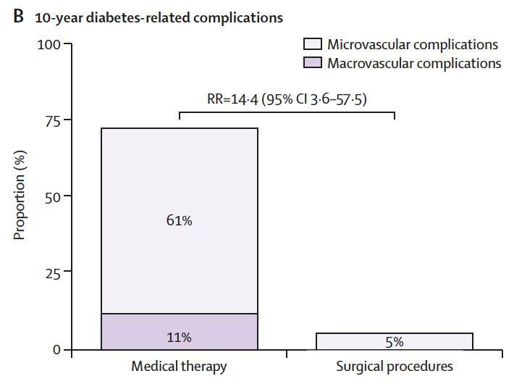
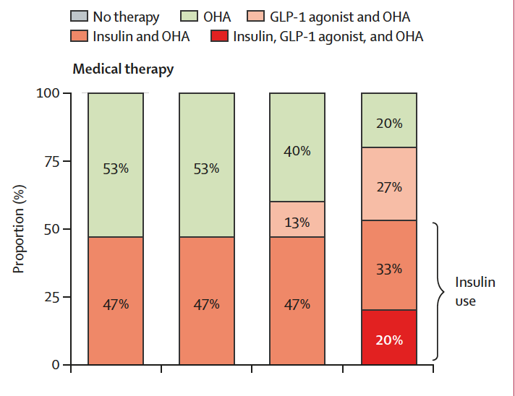
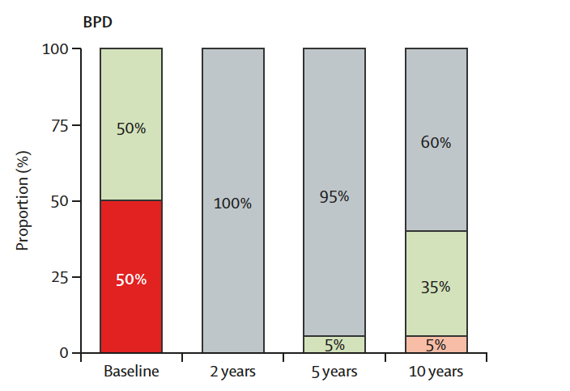

10-Year Outcomes of Metabolic Surgery for Type 2 Diabetes
Surgical treatment of diabetes, beyond remission
Control of glycaemia (HbA1c)
Quality of Life (QoL)
Diabetes-related complications
Medication Usage
Jan 2021
vs

Slide 20
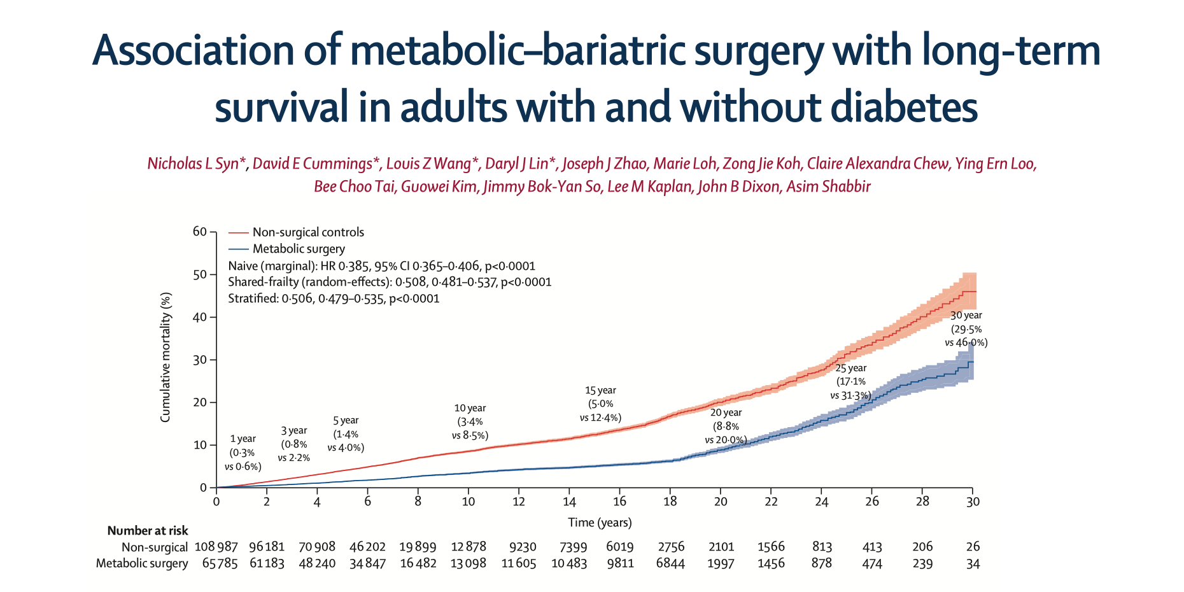
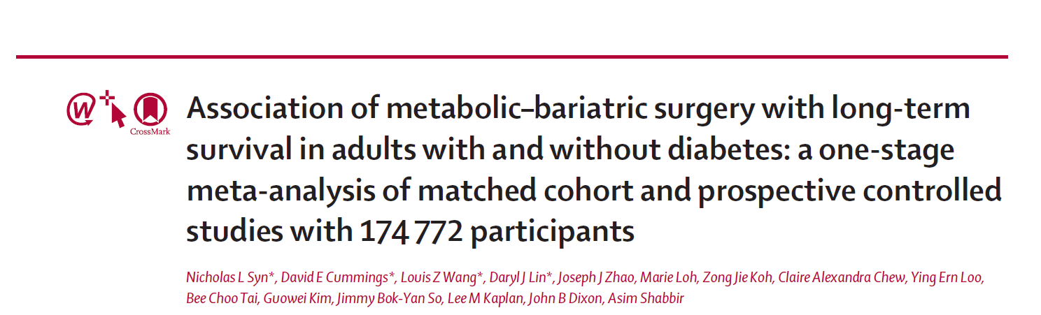
Metabolic Surgery:
A “Life-Saving” Treatment
Reduction of all cause mortality
Overall ~50%
Pre-existing diabetes (~60% reduction)
No diabetes at baseline (~30% reduction)
Meta-analysis
174,772 individuals
with 1·2 million person-years
of follow-up

Slide 21

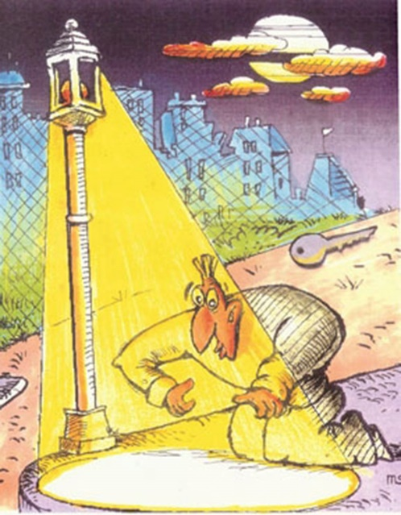


The Einstellung Effect
Brief mechanistic considerations: diabetes remission is not due to weight loss
Bariatric surgery > diabetes remission
WEIGHT LOSS !!!

Slide 22
Interventions that exert weight-independent effects on T2D
Fasting
VLCD
Physical exercise
Insulin
Drugs (e.g. Metformin, GLP-1 analogues)
GI device-based interventions
Metabolic Surgery

Slide 23
The Weight-Loss Dogma
WL is not a “prescription” –
it is a consequence of an intervention
Stating weight loss induces diabetes remission after surgery is dogmatic and not scientifically supported
and Perpetrates weight stigma
  > patients that are more ”compliant” achieve greater diabetes remission *
  > “failure” to achieve attributed to individual responsibility
* Direct Study
Lancet 2018

Slide 24
Most effective treatment today, as the public sees it
“What is the most effective treatment today for type 2 diabetes?”
“What is the most effective treatment today for severe obesity (BMI>35)?”
2023 survey of 1,017 adults in the USA and UK.

Slide 25
With no alternative at all, people still said no to bariatric surgery (weight loss surgery)
≈1%
The other 99%
Diet and commercial programmes
Self-management, repeated cycles
Or nothing at all
or less of eligible people ever chose an operation
Across the entire pre-pharmacotherapy era.
They opted out of surgery against a known-inferior alternative.

Slide 26
SURGERY
“Disease Treatment” or “Prophylactic Intervention?”

Slide 27
The rule people generally use
If it is not broken, do not fix it — surgically.
Present, established, demonstrable dysfunction.
Surgery is for what is broken
Not for what might break
A certain, immediate, irreversible act is a poor instrument against a probabilistic, deferred harm.
It is a coherent decision rule — and it is not obviously wrong.
This is not a knowledge deficit

Slide 28
Evidence that people consider surgery a fix for what is broken, not for what is not (yet)
BRCA2-Mutation
Everything argues for surgery as good intervention for a risk reduction
And yet
Risk materialization approaching certainty
The feared outcome is cancer
Risk-reducing surgery is effective
It is guideline-supported and funded
Uptake is highly variable
In many settings a minority choice
Large numbers choose surveillance
Few pursue surgery

Slide 29
THE QUESTION PATIENTS INTUITIVELY ASK
“Doctor — how risky and how costly
is what you are offering me?
And how certain is the harm
you are protecting me from?”

Slide 30
Where an operation becomes rational
Risk
Harm from
treatment
Constant,
certain
Illness
Harm from
the condition
Repair is warranted
Surgical risk exists whether the patient is ill, or not

Slide 31
The payer perspective
Cost beyond most payers' horizon
Cost to the payer
Already ill
At risk — hypothetical
Budget horizon
Time
The at-risk patient's cost may never arrive — and if it does, it may well arrive on somebody else's balance sheet.

Slide 32

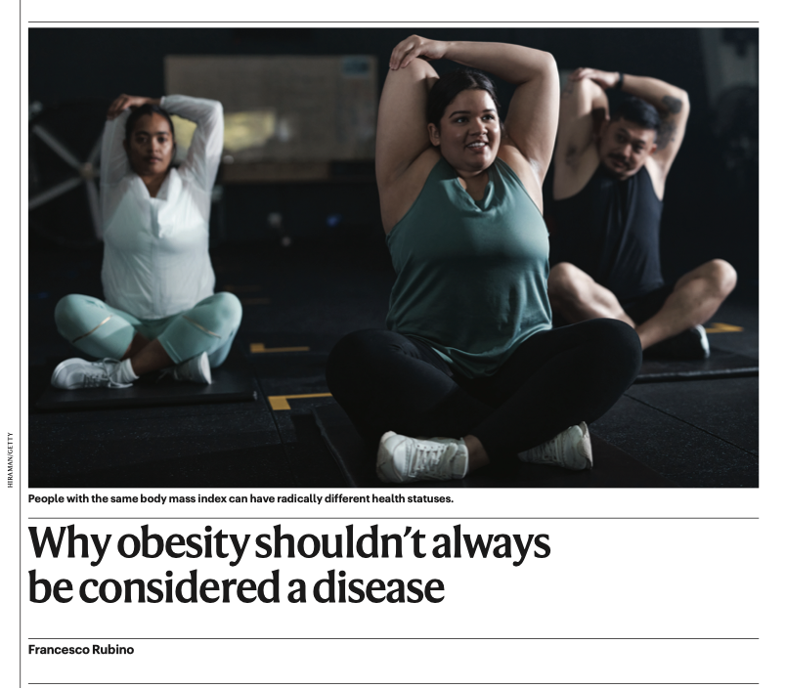
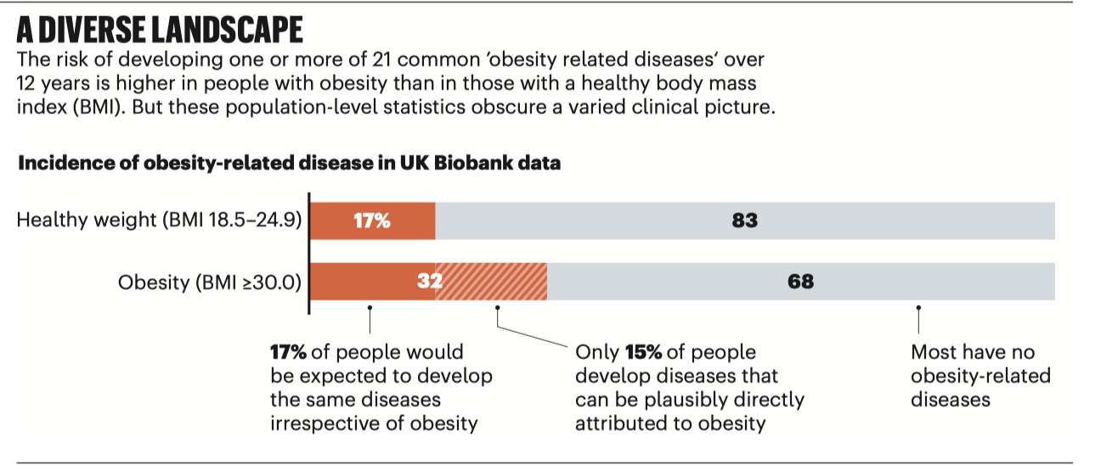
If the rule is “fix what is broken,” we have to define broken

Slide 33
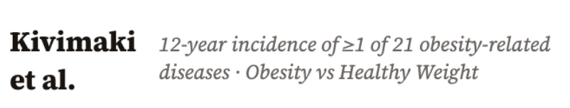
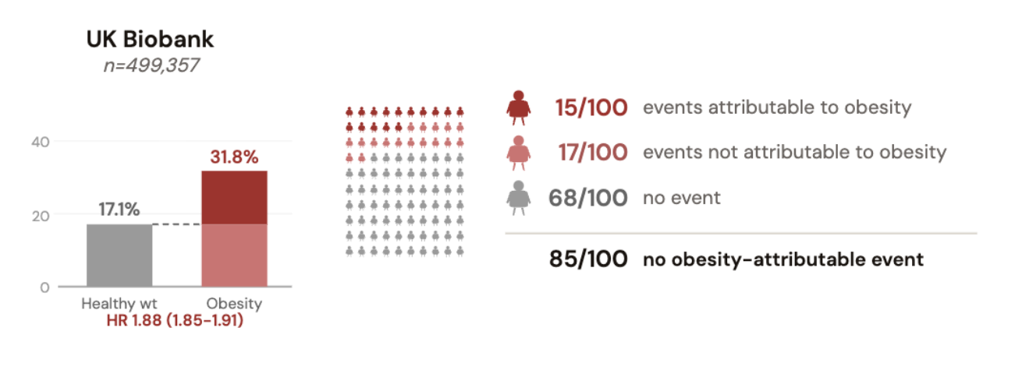
Individual-level perspective: 12-year incidence of 21 obesity-related conditions:

Slide 34
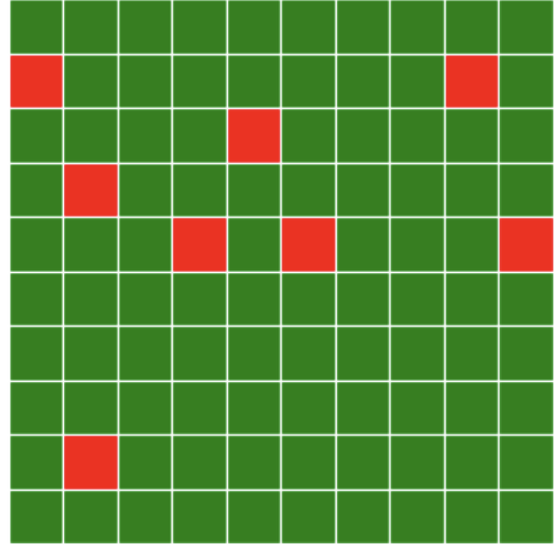
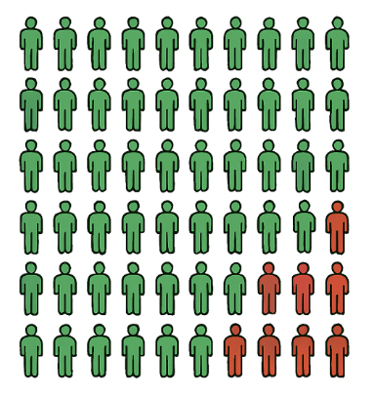






OBESITY: PUBLIC HEALTH vs CLINICAL APPROACH
Obesity
Epidemiologist
Public Health Official
Insurer
Policymaker
Clinician
Affected
Not Affected
Patient

Slide 35
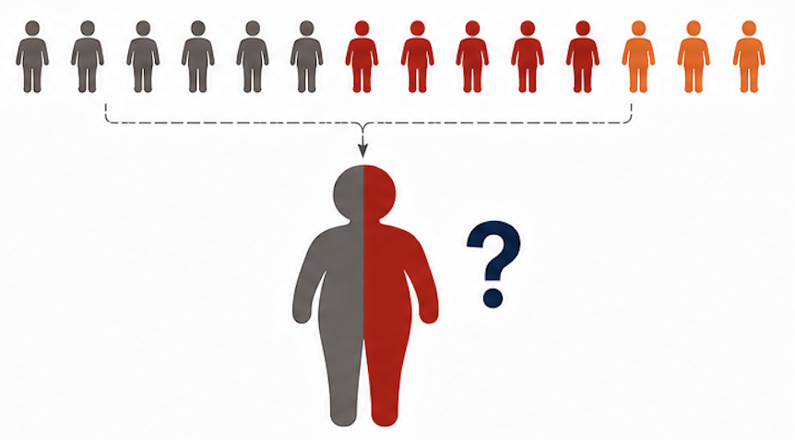
Obesity

Slide 36
The Lancet Commission redefinition of obesity
Clinical obesity
Pre-clinical obesity
Ongoing organ dysfunction, or limitation of daily activities, directly attributable to excess adiposity.
Excess adiposity with preserved organ function and preserved daily activity — carrying elevated future risk.
ACTIVE DISEASE
Diagnosed on objective evidence of dysfunction — not on BMI alone.
A risk state,
not a present illness.

Slide 37
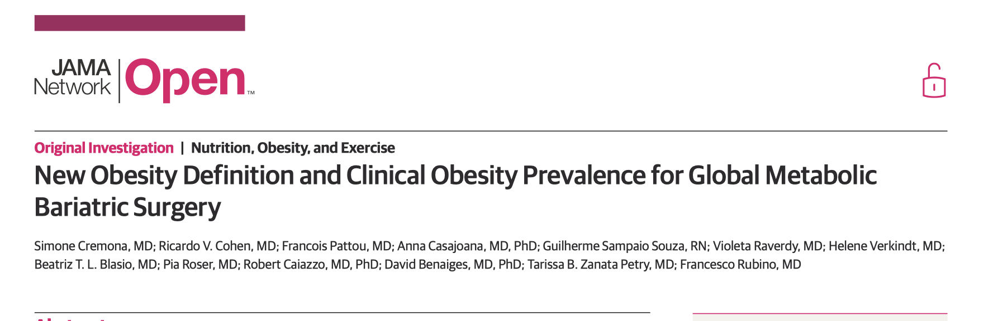
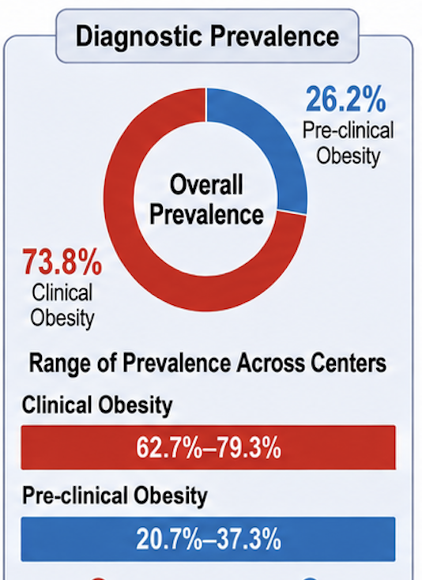
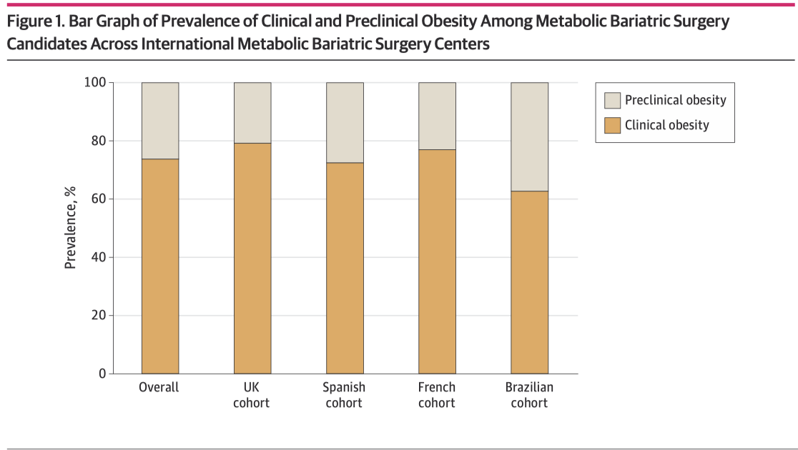
Study population: multi-centre international audit
Routine practice at 4 high-volume tertiary centres (UK, Spain, France, Brazil). n = 2,316 adult candidates undergoing primary metabolic bariatric surgery (gastric bypass or sleeve gastrectomy).

Slide 38
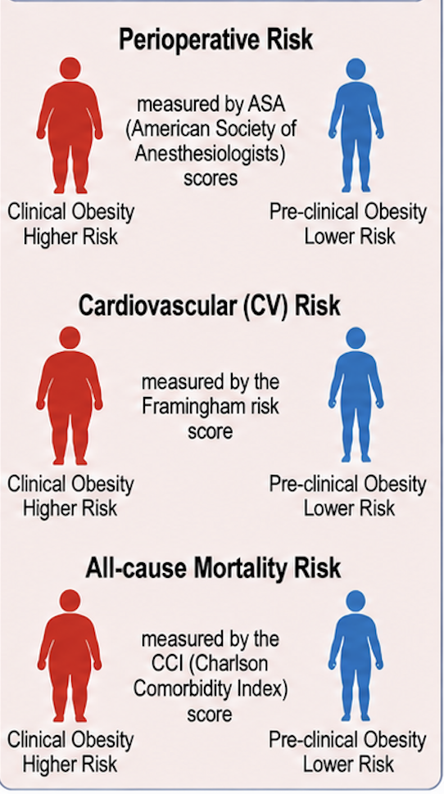
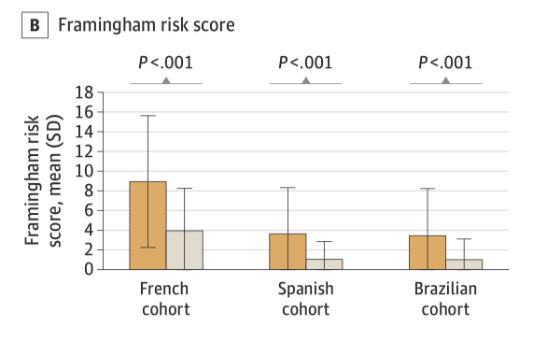
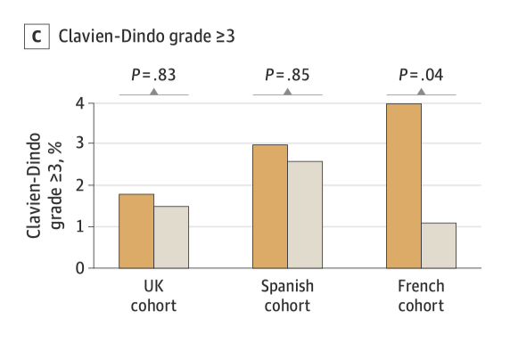
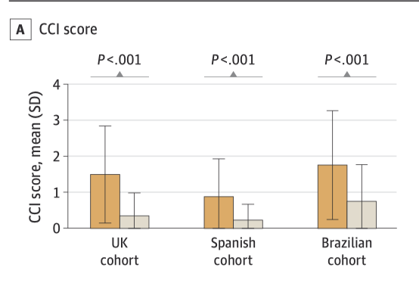
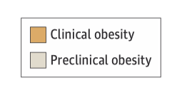

Slide 39
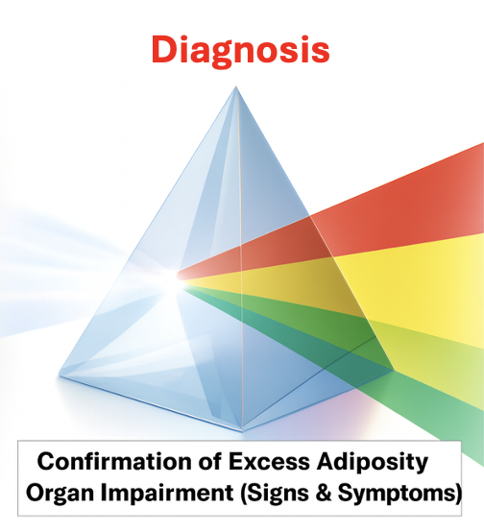

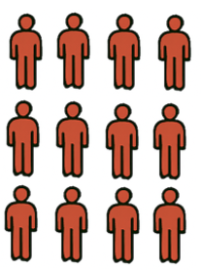

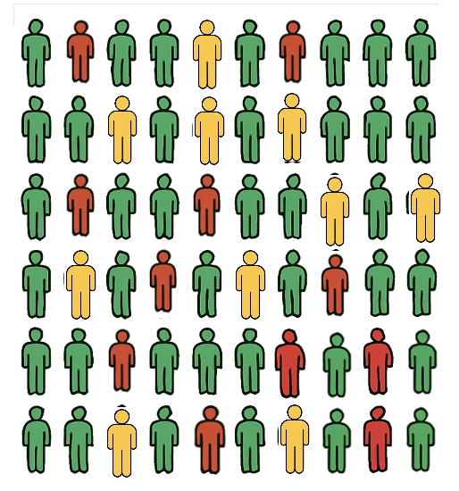

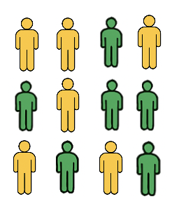
Clinical Obesity
Obesity
Disease
Staging
Pre-Clinical
Obesity
Risk-
Scoring

Slide 40
The difficulty lies not so much in developing new ideas as in escaping from the old ones.
John Maynard Keynes The General Theory of Employment, Interest and Money (1936)

